Slide 1
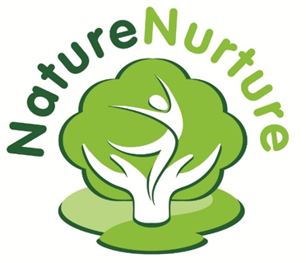
Strategies to support the development of resilience in outdoor settings
Running Forest School with Vulnerable Individuals

Slide 2
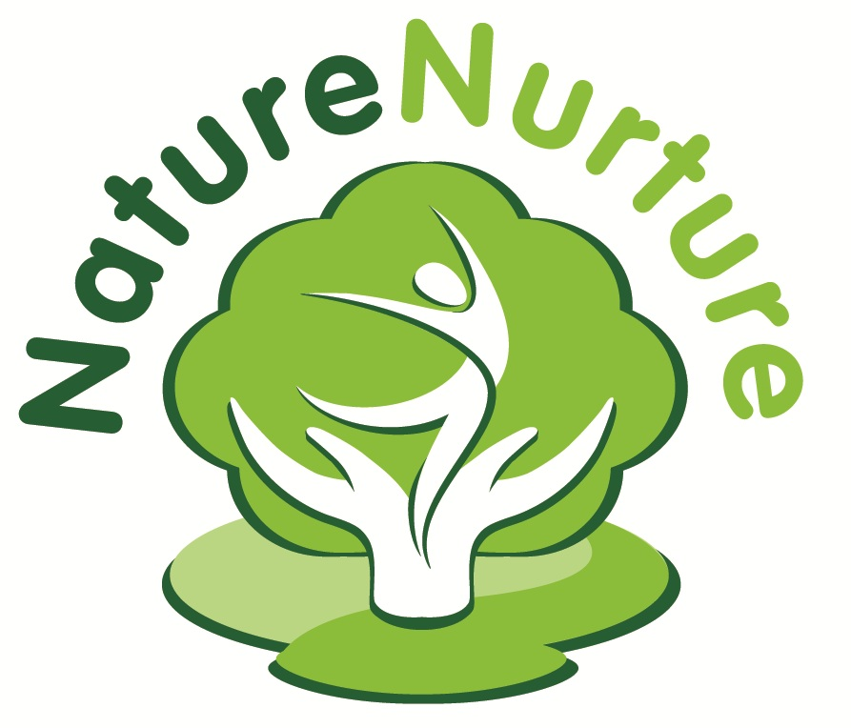
Nature Nurture
Delivers preventative and early interventions to vulnerable children, young people and their families.

Slide 3
Nature Nurture
Our programmes are designed to promote the individual’s development of resilience.

Slide 4
Nature Nurture
Our tools are free play and nurturing interactions outdoors in stimulating natural environments

Slide 5
Recovery involves far more than stabilisation of chaotic lives and minimisation of harm, but includes recovery of hope for the future. Colin Mackenzie, Routes to Recovery

Slide 6
Resilience
1
‘He who has a why to live for
can bear with almost any how’
Friedrich Nietzche

Slide 7
Resilience
That quality of an individual that enables them to persist in the face of challenges and recover from difficulty or hardship. Colby Pearce
Normal development under difficult circumstances Fonagy et al
Inner fortitude
‘Bounce-back’

Slide 8
Resilience can be viewed as........
Vulnerability
Resilience
part of a continuum with it’s opposite being vulnerability.
a dynamic process rather than a static state.
an attribute that is affected by nature (genes and innate faculties) as well as nurture (environmental/ relational influences)
a state that impacts on and is influenced by the whole development of the individual; physical, emotional and cognitive.

Slide 9
How can resilience be observed and measured?
2
The Nature Nurture project has designed a tool to aid the understanding and measurement of resilience in children and young people;
‘The Seven Building Blocks of Resilience’

Slide 10
How can resilience be observed and measured?
Our model builds on the work of Daniel and Wassell (2002)and Grotberg (2000).

Slide 11
How can resilience be observed and measured?
‘The Seven Building Blocks of Resilience’
Mental and emotional health and wellbeing
Physical health and wellbeing
Social health and wellbeing
Talents and interests
Positive Values
Creativity and imagination
Knowledge and Understanding

Slide 12
Observation and Assessment Informs Practice
Intervention for each individual is crafted using the insight gained from observation and assessment and applied using the tools of Nature Nurture:
Nature
+
Nurture
+
Play
=
Resilience

Slide 13
Barriers to Resilience – what are the influencing factors that make individuals vulnerable?
3, 4, 5
Too much stress
Anxiety
Learning difficulty or disability
Addiction
Poor mental health
Long term physical illness of self or significant other
Abuse

Slide 14
Stress and trauma

Slide 15
Simulation, stress and challenge
Under stimulation
Overwhelming stress

Slide 16
Chronic
Stress
Trauma
Complex Trauma
Stress
PTSD
PD

Slide 17
Agency, Self Efficacy, Empowerment, Resilience

Slide 18
Strategies we can use in Forest School to promote Resilience
Nature
+
Nurture
+
Play
=
Resilience

Slide 19
How Nature Supports Resilience:
6

Slide 20
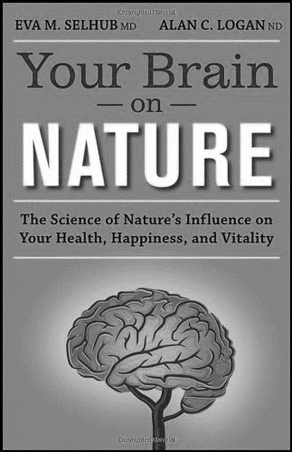
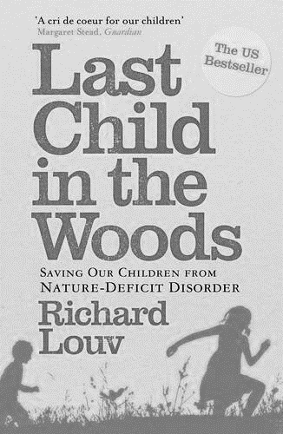

Slide 21
Studies have shown that nature improves mental and emotional health and wellbeing
“… ‘green exercise’, comprising of activity in green places (in the presence of nature), is predicted to lead to positive health outcomes, as well as to promote ecological knowledge, foster social bonds and influence behavioural choices.”
Pretty, J., Angus, C., Bain, M., Barton, J., Gladwell, V., Hine, R., et al. (2009). Nature, childhood, health and life pathways

Slide 22
Studies have shown that nature improves mental health and wellbeing
Children with symptoms of Attention Deficit Hyperactivity Disorder (ADHD) are better able to concentrate after contact with nature (Faber Taylor et al. 2001).

Slide 23
Studies have shown that time in nature reduces stress
‘Nature buffers the impact of life stress on children and helps them deal with adversity. The greater the amount of nature exposure, the greater the benefits’
Wells 2003

Slide 24
Studies have shown that time in nature reduces stress
‘Less contact with nature, particularly in one’s young years, appears to remove a layer of protection against psychological stress and opportunity for cognitive rejuvenation’
Your Brain on Nature: Eva M. Selhub MD and Alan C. Logan ND

Slide 25
Studies have shown that time in nature reduces stress
Theorists suggest the underlying mechanism for this benefit works because natural environments do not require large amounts of information to be processed and therefore an individual’s arousal (stress) level is reduced by spending time in such settings.
(Ulrich 1979)

Slide 26
Studies show that time spent in nature promotes emotional health and wellbeing
Results from studies indicate that positive emotional states can be achieved and enhanced during time spent viewing natural settings, as well as during contact with nature
Faber-Taylor et al 2001, Kellet and Derr 1998

Slide 27
Studies show that time spent in nature promotes emotional health and wellbeing
Physical activity in natural settings greatly improves positive emotions, self-esteem and behaviours.
Bolderman et al,2004;
Health Walks Research and Development Unit, 2000;
Humpel et al. 2004;
Morris 2003

Slide 28
Studies have shown being outdoors in natural spaces supports positive social interaction
The outdoor environment is perceived as a social space which influences children’s choice of informal play activities and promotes healthy personal development. Through outdoor exploration nature allows for unstructured play, generating a sense of freedom, independence and inner strength which children can draw upon when experiencing future incidents of stress.
Pretty, J., Angus, C., Bain, M., Barton, J., Gladwell, V., Hine, R., et al. (2009). Nature, childhood, health and life pathways

Slide 29
Studies have shown being outdoors in natural spaces supports positive social interaction
Natural environments stimulate social interaction between children
Moore 1986, Bixler, Floyd & Hammutt 2002.
Natural settings promote social exchanges and interactions which result in positive emotional states and behaviours.
Bertara 2003; Bowling et al. 2003; Glass et al. 2006; Kweon et al 1998

Slide 30
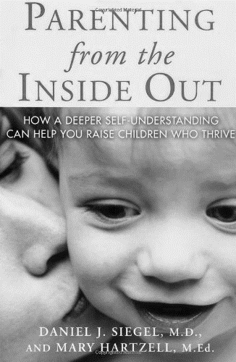
Nurturing… the role of relationship
7
Daniel Siegel, 2005
Bruce Perry, 2011
Sue Gerhardt, 2004

Slide 31
Why is a ‘nurturing’ attitude important for all ages?
8
‘The paradox is that people need to have a satisfying experience of dependency before they can become truly independent and largely self-regulating’
Sue Gerhardt, Why Love Matters, 2004

Slide 32
Nurturing is the synchronised dance between adult and child
The brain is an organ of adaption that builds its structures through interactions with others. In the brain love takes material form.
Dan Siegel’s Practices of Integrative Communication (2005)
: The steps towards nurturing interactions:
Awareness: of own inner state, body language and the nonverbal signals of the child
Attunement: allowing our inner state to align with that of the child
Empathy: Be open enough to sense the child’s experience and point of view
Expression: Communicate your own internal responses in a respectful manner
Joining: Share openly in the give and take of communication, verbally and non-verbally
Clarification: Help make sense of the child’s experience
Sovereignty: Respect the child’s dignity, uniqueness and separateness

Slide 33
How can we support interactional rhythms?
Have you noticed that when people jog, dance or throw a Frisbee in rhythm with each other, they seem to experience momentary bonding and a sense of unity?
At these and other moments of joint rhythmic engagement, they discover an attraction for each other regardless of whether there has been a previous sense of caring.
In fact, it is almost impossible to dislike a person while being rhythmically in "sync.“
Rhythmic interactions forge people together. Rhythmicity provides a "glue" for establishing human connections. The value and power of these pulsating interactions may offer an eye opener for the practice of care interactions of young and old, for caregivers and care receivers alike. (Maier, 1992)

Slide 34
From ‘Rhythmicity’ by Henry Maier
‘An awareness of conjoint engagement will likely help us to pace our interactions.
It can further our capacity to interact and to speak with rather than to a person.
It seems that the focus partially shifts from what we do or say to finding together a synchrony: recognizing "the kind of rhythm they are moving in, as well as the many tiny unnoticeable events that make up any transaction" (Hall, 1976, p. 71).
These observations have an important potential message for care interactions: finding a mutual and sustained rhythm is one challenge of care work’

Slide 35
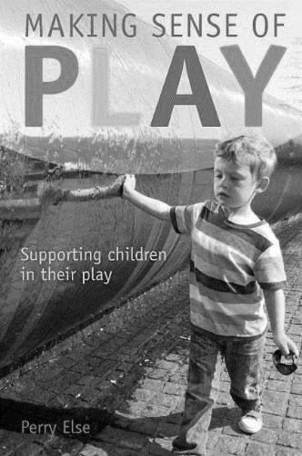
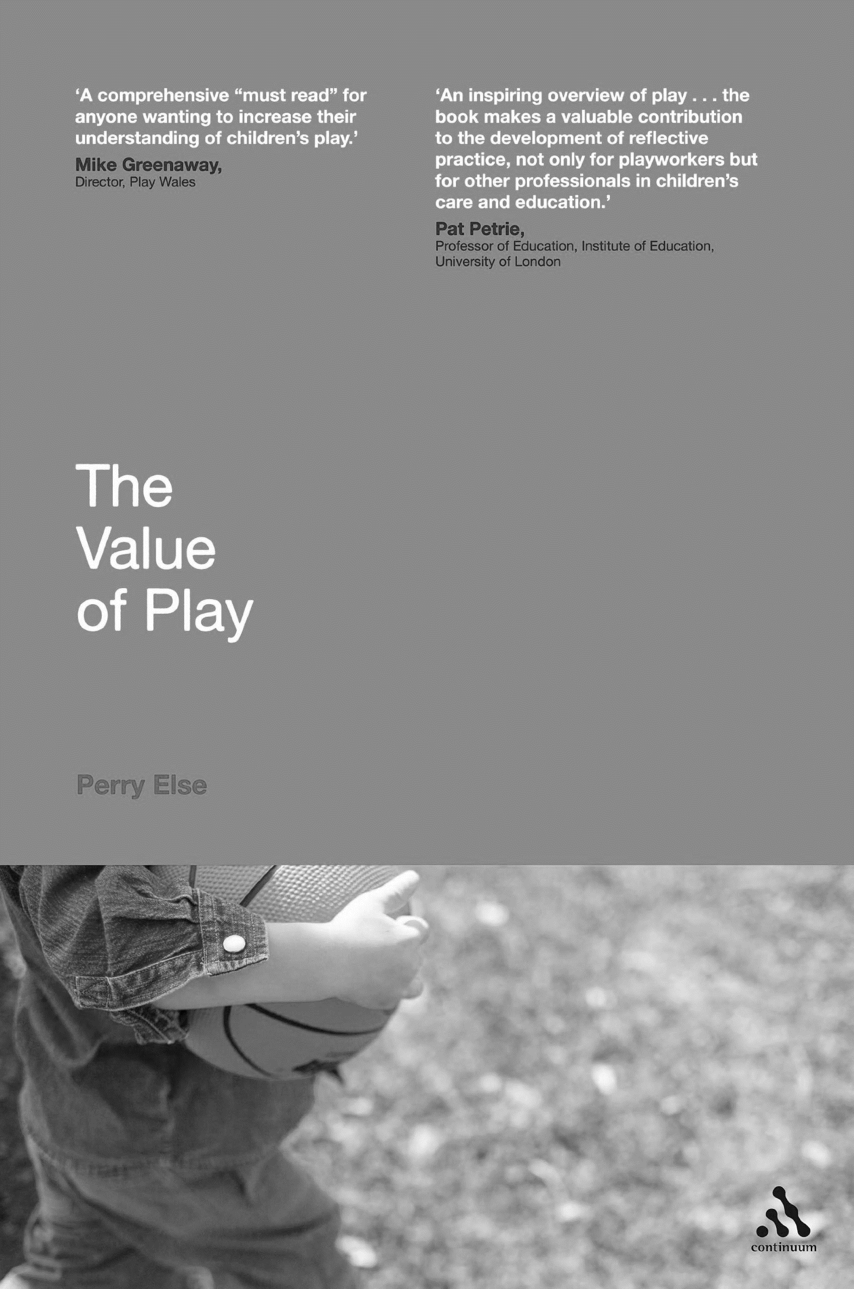
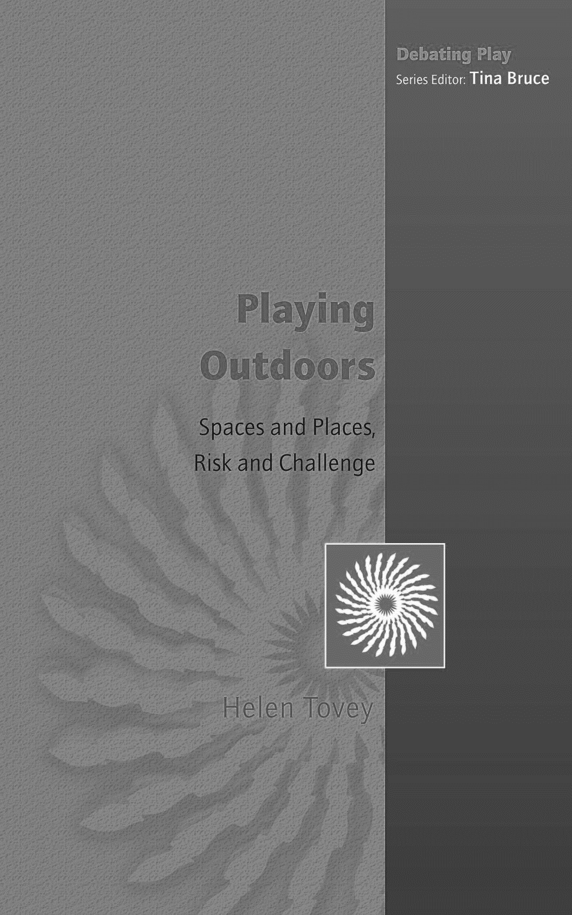
Perry Else, 2014
Perry Else, 2009
Helen Tovey, 2007

Slide 36
Play is: Freely chosen
Play is: intrinsically motivated i.e performed by the child for no external goal or reward
Play is: personally directed by the child

Slide 37
How can we support play rhythms?
Rhythm is also significant in play through the give-and-take with clear cycles of approach and withdrawals, continuously maintaining each other’s rhythm. When play is synchronised in this way, meaningful relationships are established in those moments that the child wishes to revisit or maintain.

Slide 38
Children naturally play rhythmically:
Pouring water from jug to cup and back again.
Peek-a-boo
Rocking and swinging
Repeated play sequences
Rolling a ball up and down, back and forward
Throwing and catching
Children enjoy the predictability of rhythmic and repetitive play
Children’s songs and action rhymes acknowledge this need.
Every time we sing, follow a ritual, walk in unison, greet and say goodbye, we are helping children to experience the continuous predictability of life that helps them feel secure and safe.

Slide 39
How can we support group dynamic rhythms?
Groups of children at play have been found to share a rhythm and synchrony even if they are not all playing together or the same game.
When working with groups of children it is important we start to become aware of the group’s ‘pulse’.
Children also follow an ‘expansion/contraction’ rhythm in their group and solitary play. Adults need to facilitate this flow in and out of the group by becoming aware of each child’s need.

Slide 40
Strategies we can use in Forest School to promote Resilience
Nature
+
Nurture
+
Play
=
Resilience

Slide 41
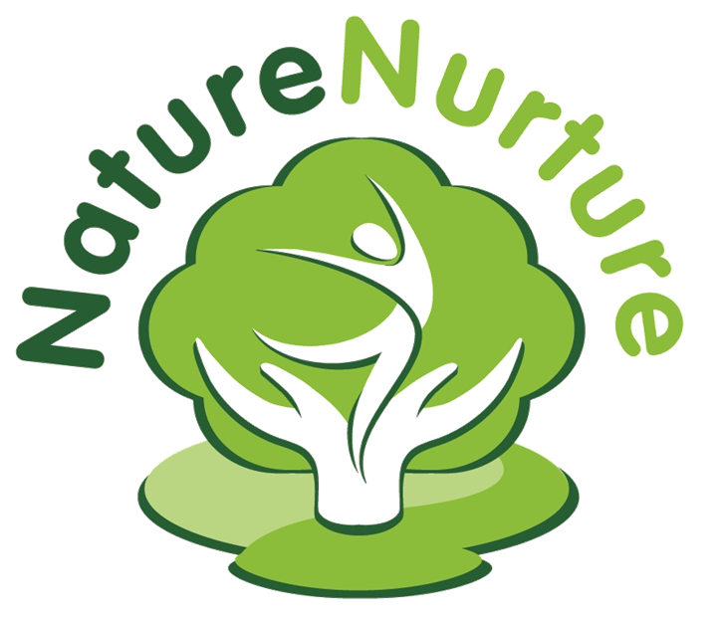
Thank you for listening!
For more information on the Nature Nurture approach, CPD training and Post Graduate courses, please contact:
Terri Harrison
Nature Nurture
Railway Cottage
Bieldside
Aberdeen
AB15 9EU
t.harrison@naturenurture.org.uk
@_NatureNurture
http://naturenurture.org.uk
www.facebook.com/NatureNurture

